Slide 1
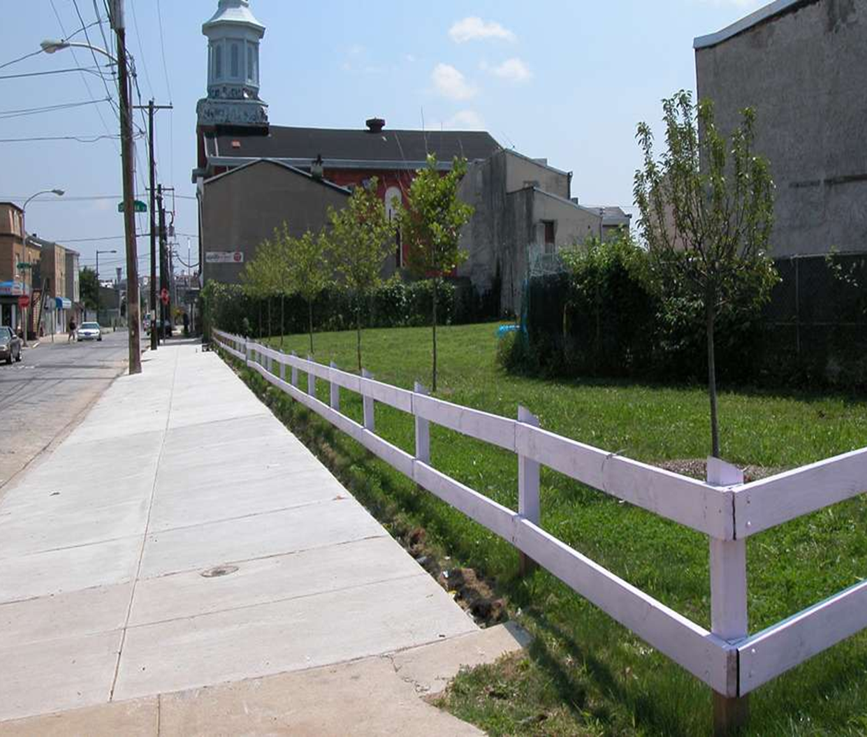
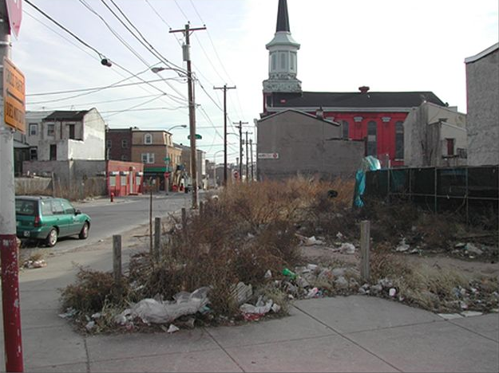
Identifying Vacant Parcels May Just Save Lives
Laura Lazarescou, Andrew Mejia, Tina Pai and Sabrina Purvis

Slide 2
Outline of presentation
Start with the conclusion – by simple i
Dallas Mayor taskforce – background on the statistics
Define vacant parcel
Why specifically are vacant parcels a problem? Incivilities & broken windows
What is a solution (Philly)
Why does Dallas need our help? - What is our hypothesis
Data background / source
Methods
EDA
Modeling – Vacant parcels
Solutions
Next Steps – Recommender Systems (?)
Wrap up – Questions?

Slide 3
City of Dallas

